Slide 1
CEng 491 - Fall 2023
First lecture

Slide 2
Course staff
Pelin Angın, Gökberk Cinbiş
(Coordinators)
Anıl Çetinkaya, Bilgin Coşkun, Merve Asiler
(Teaching Assistants)

Slide 3
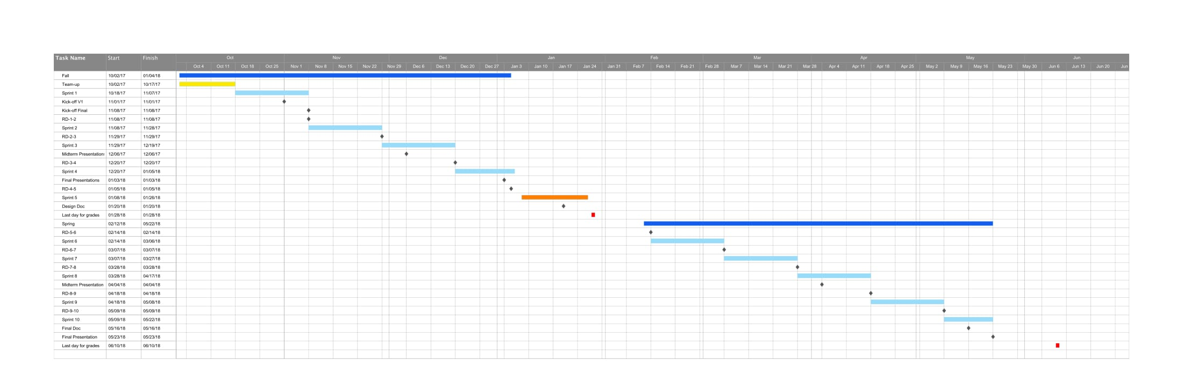
Senior Design Project
491+492 as a whole: a (almost) real-life project development experience
Application of your basic software & hardware engineering knowledge to a real-life problem/project.
Team work
5 developers
1 supervisor (acting as the boss)
++ assistants/ coordinators
Spans 2 semesters, 4+4 credits !!!!
Expectations are high!
Both the quality and the quantity of your work are important!
Notes:
This is a two semester course.
You will apply basic software and hardware engineering knowledge to develop a real-life project.
Each team will have 5 developers, 1 supervisor, 1 comm. assistant and coordinators.
In this course, Our expectations are high for your works both in terms of quality and quantity.

Slide 4
Course characteristics
Agile Methodology
Iterations (Sprints)
Plan what to do
Do what you plan
Revise your plan (+/- todo items)
Iterate
There will be a lecture about agile development.
Notes:
During the course we will stick to agile methodology working through iterations.
You will have a lecture about agile development.

Slide 5
Course characteristics (cont’d)
Each week we have 2 lecture hours (Thursdays 11:40-13:30) + 4 lab hours (Wednesday 13:40-17:30). Lecture hours are for:
Lectures
Seminars
Team presentations (kickoff, midterm, design, coordinator meetings)
Lab hours are reserved for weekly meetings (next page)
Notes:
Each week, on Fri, you will have 2 lecture hours for lectures, seminars, team presentations such as midterm and coordinator meetings.
Besides this, you will also have 4 lab hours on Wednesdays. In these hours you will meet with your assistant and supervisor.

Slide 6
Weekly meetings
Required: Weekly student-only meetings (ideally) on Wednesdays, for status review & week planning. Review your status w.r.t. your goals in kickoff & retrospective document (and 49x deadlines).
Optional: weekly meetings with your supervisors => NOT MANDATORY.
Why?

Slide 7
Weekly meetings
Required: Weekly student-only meetings (ideally) on Wednesdays, for status review & week planning. Review your status w.r.t. your goals in kickoff & retrospective document (and 49x deadlines).
Optional: weekly meetings with your supervisors => NOT MANDATORY.
Why?
It is your own project, your own responsibility to plan the week ahead
Work as a group, hold weekly meetings
If you're having a problem (eg. a member is not contributing well), take meeting memos on what has been done and what will be done, and who has missed the meeting.

Slide 8
Course characteristics (cont’d)
Work will be done in 3-week sprints.
We will have 4 sprints this semester. (Check the syllabus for start/end dates)
There will be in-class presentations. These will be considered as oral exams:
1st: 2 min. elevator pitch per group, just around the time for submitting the first kick-off document draft.
2nd: towards the end of the semester.
There can be coordinator meetings. These will be considered as oral exams as well.
Mandatory sprint demos to project supervisor(s). (More about this later)
Notes:
During the semester you will have 4 sprints and each lasts 3-weeks.
You could find the dates and deadlines in the syllabus.
You will have in-class presentations that will be graded as oral exam.
The first one is 2 minutes elevator pitch per group, just after submitting the first kick-off document.
The second one will be towards the end of the semester.
Coordinator meetings will be considered as oral exams as well.

Slide 9
Course characteristics (cont’d)
Documentation: We try to keep it at a minimum.
You will deliver a kick-off document at the beginning
and a design document at the end of the semester.
You will deliver a retrospective document at the beginning of each sprint.
Notes:
During the course you will deliver several documents.
You will deliver a kick-off document at the beginning and a design document at the end of the semester.
You also will deliver a retrospective document at the beginning of each sprint.

Slide 10
Timeline
 | Start (Wed's) | End (Tue's) | Supervisor demo & retrospective deadline
Sprint 1 | 18-Oct | 7-Nov | =(End date+1) - ie. Wednesdays
Sprint 2 | 8-Nov | 28-Nov
Sprint 3 | 29-Nov | 19-Dec
Sprint 4 | 20-Dec | 9-Jan
Deliverable | Tentative deadline
Kickoff Doc V1 | 16-Oct
Elevator pitch | 17-Oct
Kickoff Doc V2 | 29-Oct
Design Doc | 17-Jan
Midterm Presentation | 27-Dec
See syllabus for more details
Notes:
These are current deadlines.

Slide 11
Course characteristics (cont’d)
Classical course vs 49x
In a classical undergrad course, there are well-defined assignments and written-exams. Their answers/solutions are known.
In 49x, answers/solutions are not known or defined!
This creates a difficulty for grading.
491 grading more subjective. We always try to reduce this.
So, focus on the total quality of your work rather than individual grading items.
Notes:
There are several differences between this course and classical courses.
….

Slide 12
Seminars
Technical/Technological topics (Hardware, Software)
Project Management
(Engineering) Ethics, Social Responsibility
Innovation
Entrepreneurship
Intellectual Property (Patents, etc.)
Open Source
Professional Society
And more…
Notes:
In the seminars will be talking about several topics. In several week we will also have guests for the seminars.

Slide 13
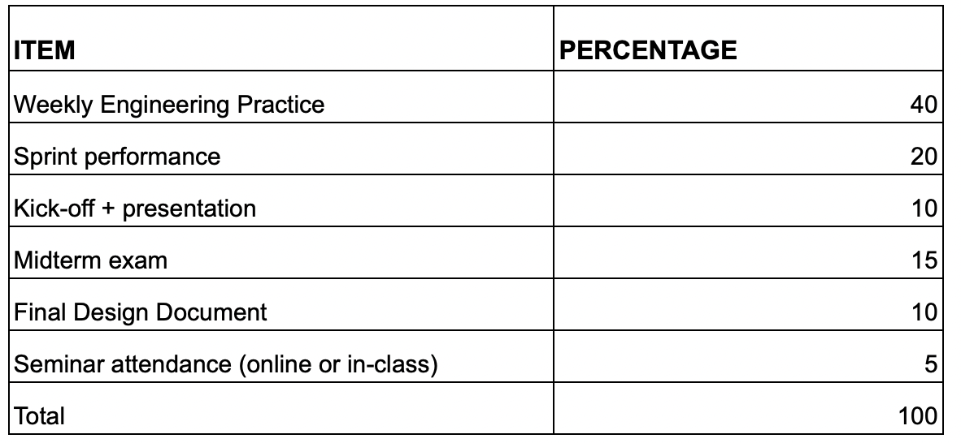
Grading
Notes:
And these are the grading items and their percentages for the course.
As you could see Weekly Engineering Practice item has an important role here.
Course assistants will grade your individual performances weekly.

Slide 14
Grading - WEPs (next week, more details by TAs)
% 40 --- TriWeekly engineering practice (WEP) - by your TA
Criteria overview (for individuals):
The general progress
The amount of work done
The quantitative and qualitative usage of GitLab
The meeting agendas (GitLab)
Attendance to the meetings
Individual level gradings
Notes:
The first grading item is Weekly engineering practise - WEP for short.
We, course TAs, will be grading;
your general progress,
the amount of the work done,
your attendance to the meetings and
your weekly meetings with your supervisor as a WEP.

Slide 15
Grading - WEPs (next week, more details by TAs)
% 40 --- TriWeekly engineering practice (WEP) - by your TA
Moving from 1 week periods to 2 week ones:
Gives you more flexibility in planning your time
But we do expect better reporting and consistency on your side:
Give attention to issue details
Do not expect "WEP dropping" (most probably)
We do expect 2 weeks work
Notes:
The first grading item is Weekly engineering practise - WEP for short.
We, course TAs, will be grading;
your general progress,
the amount of the work done,
your attendance to the meetings and
your weekly meetings with your supervisor as a WEP.

Slide 16
Grading - Sprint performance (Retro docs)
%20 --- Sprint performance - by Coordinators (Pelin & Gökberk)
Retrospective document
Progress of the team (if necessary individual grading)
Based on our assessment based on retrospective doc + supervisor's demo observations (next slide)
The accuracy of the sprint summary and the upcoming sprint plan
Supervisor feedback will significantly affect the final grading. Supervisor grades are used in scaling grading items on per-group and per-student bases.
Peer grades may also be collected & taken into account.
Upload PDF documents, NOT word documents.
Notes:
Sprint performance is another important grading item.
Your sprint performance will be evaluated by Coordinators.
Here is the basic criterias.

Slide 17
Grading - Sprint performance (Retro docs)
Supervisor demos
To your academic supervisor(s)
At the end of each sprint (on the day of retrospective doc submission, or 1-2 days before that)
Show the progress that you've made in the past 3 weeks
Show in the code
Show in the product, or parts of it
Demonstrate your work
Summarize each member's contribution
Notes:
Sprint performance is another important grading item.
Your sprint performance will be evaluated by Coordinators.
Here is the basic criterias.

Slide 18
Seminar attendance
Attendance grades
You need to be present throughout the lectures
Online vs in-class presence policy will be announced later
Notes:
Sprint performance is another important grading item.
Your sprint performance will be evaluated by Coordinators.
Here is the basic criterias.

Slide 19
Syllabus
https://docs.google.com/document/d/e/2PACX-1vSKjc9zJgptHSb4tjnjOZwiLHnsTYSKzRAwPYfftgof1PNox6sjf1tSUFspsHu_dDiXxgCpr5ZsAeG2/pub
Notes:
You could find the syllabus for this semester in the link.

Slide 20
Grading
✅
✅
Now
TBA
TBA
✅
Notes:
The midterm has 15 percentage; and documentation has 20 percentage for overall grading.

Slide 21
Kick-off docs
Your project contract
First version → mainly by you, pay a GREAT attention to general guidelines (next slide) & target a fully complete and ready-for-prime-time kickoff doc.
Second version → revisions based on our feedback.
Both 1st and 2nd versions matter in your kick-off grade.
Since this is your project contract, we may require you to do a 3rd, etc. revision until it satisfies the requirements
This likely means a low kick-off grade; all kick-offs are normally expected to meet the standards in the 2nd revision.

Slide 22
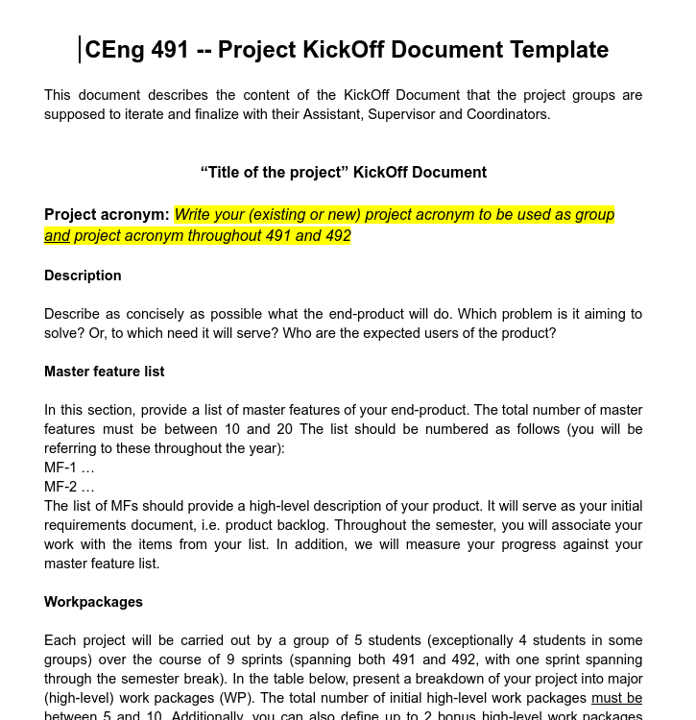
Kick-off template
https://docs.google.com/document/d/e/2PACX-1vS9UpeiedBpRADAAtPz9c0_mcfx4gPUdEAySL1kovic-Ow-sYnUFPc8o53cJ3tqOBXPx3VkNbmL6NRY/pub

Slide 23
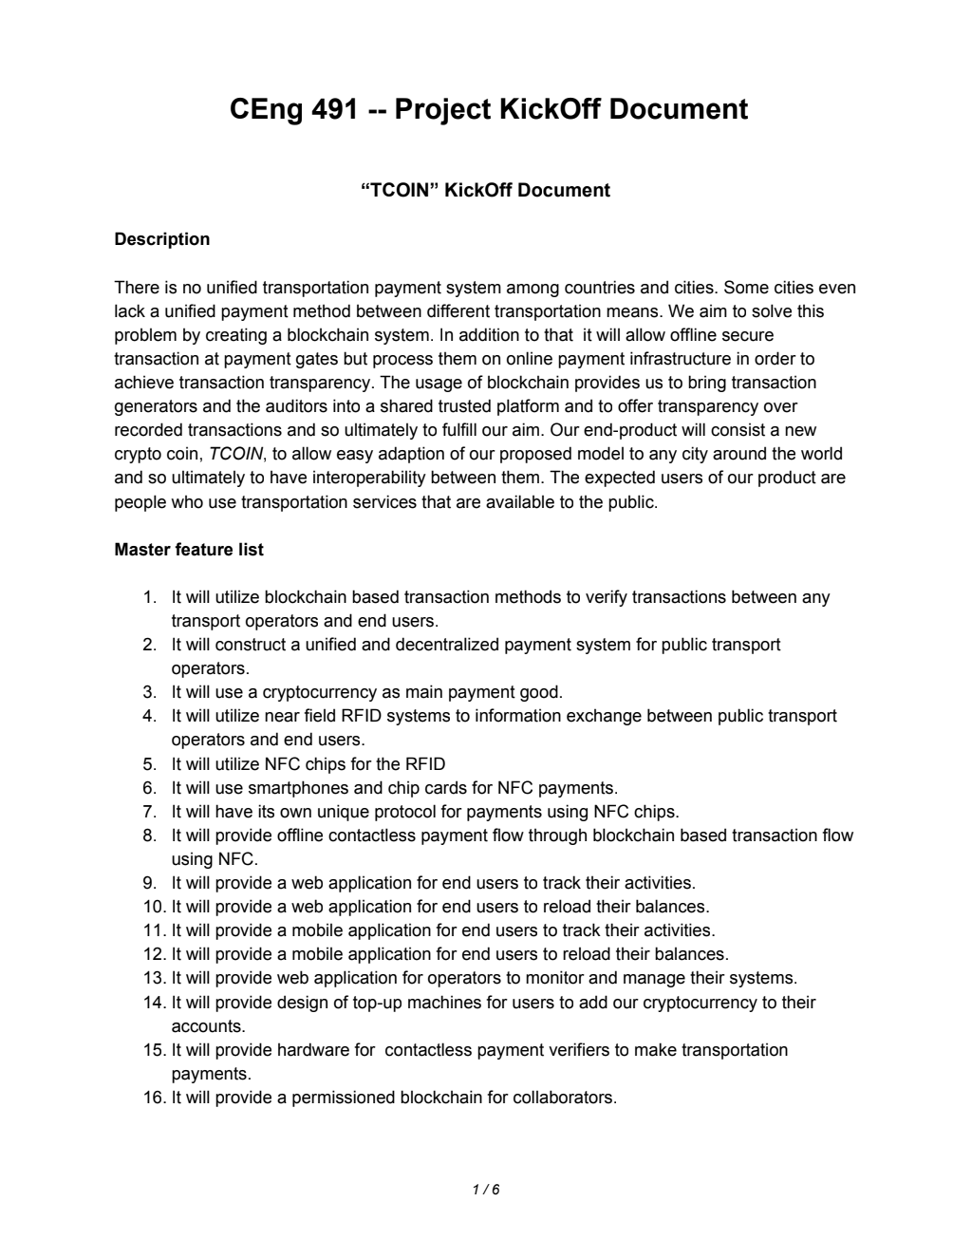
Kick-off example
https://senior.ceng.metu.edu.tr/2020/tcoin/docs/kickoff.pdf
Alt. link: https://drive.google.com/file/d/1AzJD9sg1FyJrxaLuAK9tI3SlNMWRkFb3/view?usp=sharing
Do not over-fit to this one example!!!
Also note that this is based on a prior kick-off template, not all details are fully compatible.

Slide 24
General proposal/kickoff guideline
Keep this in mind as the ultimate guidance:
As a group, you're working on your startup project.
Investors want to see a clear plan.
You want to have a clear plan.
You want to build a product and you need to know exactly what you'll build.
Target a good balance between simplicity & sophistication:
You're senior year METU CENG students! We want to see software projects with sufficient software engineering (design & development challenges)
But we also want your projects to be clear & well-defined.

Slide 25
Common proposal/kickoff mistakes
Too much research
Avoid open-ended research problems
You like research? Great! We love research. But this isn't the course for research projects (check out CENG488).
A common case: machine learning? Sure, but only if you're existing tools & architectures & datasets, rather than creating new ones. It should be well-defined & applied.
Product is not clear enough
Product is not innovative enough
Closely related: insufficient software design / development challenges
Poor document quality

Slide 26
Finalize project topics & teams
All groups must have their project & supervisor lists finalized
First sprint starts: in the third week of the semester
Communication TAs will soon be announced
WEP details → next week, by TAs
!Please check your group’s current project assignment and make sure it’s correct.
!If you do not have a group yet and have notified us, we will form your group this week and ask you to complete your project selection.
Notes:
Here you see upcoming deadlines.
So please upload your team info to ODTUCLASS by October 18.
First sprints starts on October 28 which means that you will get your first WEP grades for the week October 28 - November 3.

Slide 27
Throughout the academic year
Notes:
This is how a year looks like with sprints and midterms/presentations etc.

Slide 28
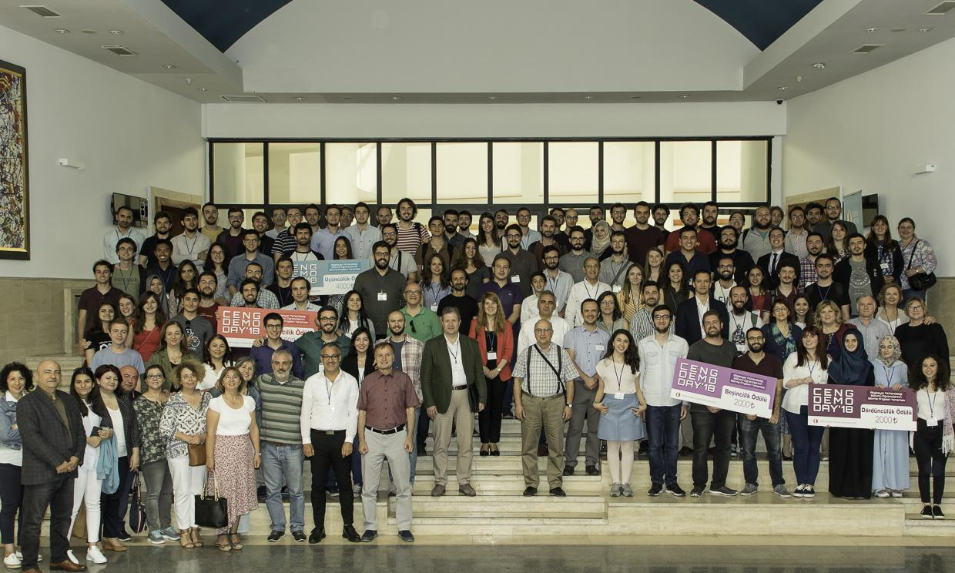
At the end, DEMO day in June 2024
Demo day: Great opportunity for you to show your work…
https://senior.ceng.metu.edu.tr/
Check the projects from previous years
Ceng Demo Day 2022
Evaluation criteria (tentative) in the next two slides.
Notes:
At the end of year in June we will have DEMO Day event which is a great opportunity for you to show your work.
You could check the event and projects from previous years.

Slide 29
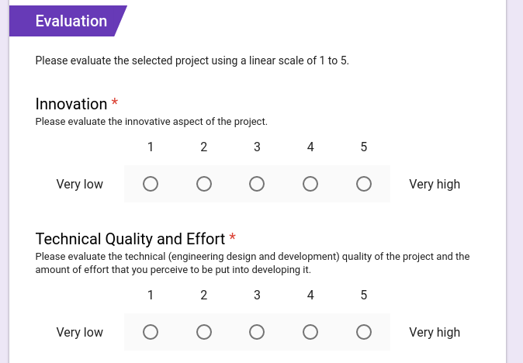
Notes:
The jury will evaluate your projects based on several criterias on DEMO Day.
The groups with highest points will be awarded.

Slide 30
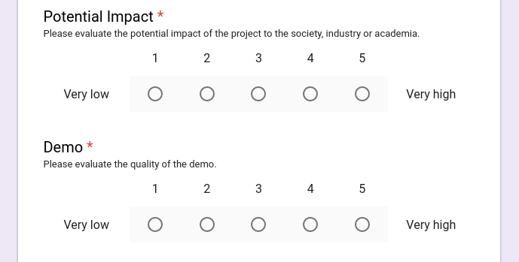
Notes:
Here is the rest of criterias for evaluation

Slide 31
Golden 49x hints

Slide 32
Golden 49x hints
READ THE ANNOUNCEMENTS, WORD BY WORD

Slide 33
Golden 49x hints
TAKE NOTE OF WHAT YOU'VE READ, ITEM BY ITEM

Slide 34
Golden 49x hints
READ THE GUIDELINES IN TEMPLATES, WORD BY WORD

Slide 35
Golden 49x hints
FOLLOW THE GUIDELINES IN TEMPLATES, WORD BY WORD

Slide 36
Golden 49x hints
LOVE SUBMITTING PDF FILES DETEST SUBMITTING WORD FILES

Slide 37
Golden 49x hints
It is hard to work as a group. MEET REGULARLY, WORK REGULARLY PUSH EACH OTHER TO DO BETTER (do not comfort each other for lousy work)

Slide 38
Golden 49x hints
When something doesn't make sense (mistakes happen), ASK

Slide 39
How to ASK?
To reach TAs (WEPs, etc):
49x-info@ceng.metu.edu.tr
To reach coordinators:
49x.coordinators@ceng.metu.edu.tr
Please have the following info:
Your name, your ID, your project acronym
For non-personal emails (ie. those related to the group), CC ALL GROUP MEMBERS.
Notes:
Sprint performance is another important grading item.
Your sprint performance will be evaluated by Coordinators.
Here is the basic criterias.

Slide 40
How to ASK?
To reach TAs (WEPs, etc):
49x-info@ceng.metu.edu.tr
To reach coordinators:
49x.coordinators@ceng.metu.edu.tr
Please have the following info:
Your name, your ID, your group project acronym
For non-personal emails (ie. those related to the group), CC ALL GROUP MEMBERS.
49x-info@ceng.metu.edu.tr
49x.coordinators@ceng.metu.edu.tr
Notes:
Sprint performance is another important grading item.
Your sprint performance will be evaluated by Coordinators.
Here is the basic criterias.

Slide 41
Questions?
Notes:
If you have any question please do not hesitate to ask.

Slide 42
TA Presentation

Slide 43
Grading
% 40 --- TriWeekly engineering practice (WEP) - by your TA
Criteria overview (for individuals):
The general progress
The amount of work done
The quantitative and qualitative usage of GitLab
The proper scheduling & narrating in Gitlab
!!! Individual level gradings !!!
Notes:
The first grading item is Weekly engineering practise - WEP for short.
We, course TAs, will be grading;
your general progress,
the amount of the work done,
your attendance to the meetings and
your weekly meetings with your supervisor as a WEP.

Slide 44
Grading
There is no group level grading in WEPs, but we will follow your group progresses.
Your group performance also will be evaluated through midterm, coordinator meetings, etc.
Workload | 36 %
Coding | 28 %
Sticking to sprint plan and justifying if/when there is devitation & Following Gitlab rules and templates | 36 %
Fake Activity | No points
Notes:
There is no group level grading in WEPs, but we will track your group progresses.
Note that your group performances also will be evaluated through midterm and coordinator meetings.
In the table you see the grading items for a WEP.
The first one is supervisor meeting agenda and minutes: We expect you to meet with your supervisor weekly, and summarize your meeting in a Gitlab issue.
The second one is Attendance: In each week after grading we will select some-groups and meet them on Wednesdays lab hours.
The third item is Coding / Research activity; where we will evaluate your coding / research performance based on your issues for that week.
Weekly Gitlab Activity: Here we expect you actively use Gitlab. Open several issues if you need, please do not put everything in a single issue.
If you open and close only one issue on a single day, you will not get full grade.
Lastly weekly workload; which will be evaluated based on your performance for that week.

Slide 45
Grading
Coding activity
4 points | if a difficult or a long algorithm was implemented [or something equivalent]
3 points | if an ordinary algorithm that requires a considerable amount of time was implemented [or something equivalent]
2 points | some copy-paste (or familiarized) code is used and it is adapted to the current needs by easy modifications [or something equivalent]
1 point | a very easy coding was done like changing values, variables, or versions [or something equivalent]

Slide 46
Grading
Workload activity
4 points | if a <totally new / nontrivial / very long time consuming / big component of a work package> is done [or something equivalent]
3 points | if a new yet ordinary (trivial) amount of work is done [or something equivalent]
2 points | if a valuable (considerable) yet easily doable or short-time-handlable work is done [or something equivalent]
1 point | if a very easy or very little amount of work requiring roughly 1-hour is done [or something equivalent]

Slide 47
Workload Rules - Gitlab Rules
You are expected to open “issues” for each specific task that you complete.
A sample WEP schedule
October 18 (Wednesday) [START] | Distribute your workload to 3 weeks. Do NOT handle all the things on the last day! Note that it becomes very clear from the issue content and scheme when you left all the things to the last day.
… 3 weeks …
November 7 (Tuesday) [END]

Slide 48
Workload Rules - Gitlab Rules
In the Retrospective Documents you define the sprint plan.
For each big task in the plan you give an unique item id.
Big
Task
Milestone
Sub
Task
Issue
Sub
Task
Issue
Sub
Task
Issue
Sub
Task
Issue
Retrospective Document
Gitlab

Slide 49
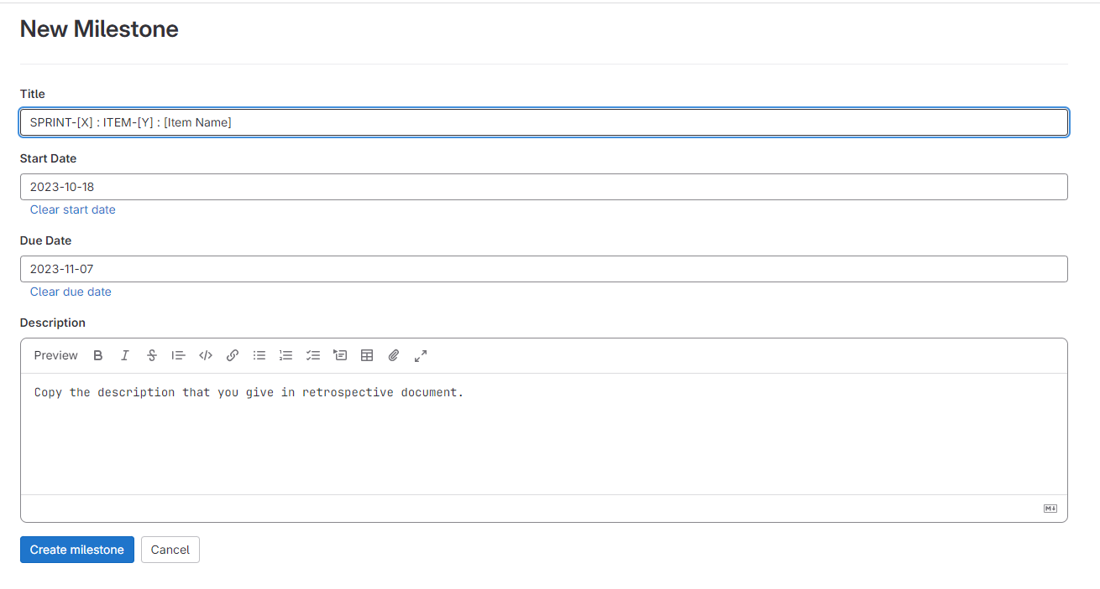
Workload Rules - Gitlab Rules
Milestone:

Slide 50
Workload Rules - Gitlab Rules
Milestone:
Title Convention: “SPRINT-[X] : ITEM-[Y] : [Item Name]”
Y is unique (you define it in the Retrospective Document).
Copy the description that you give in the Retrospective Document
If you can not complete it on time, update the description by adding the info of why you could not complete in an itemized way!
When you complete the whole milestone, close it on Gitlab.

Slide 51
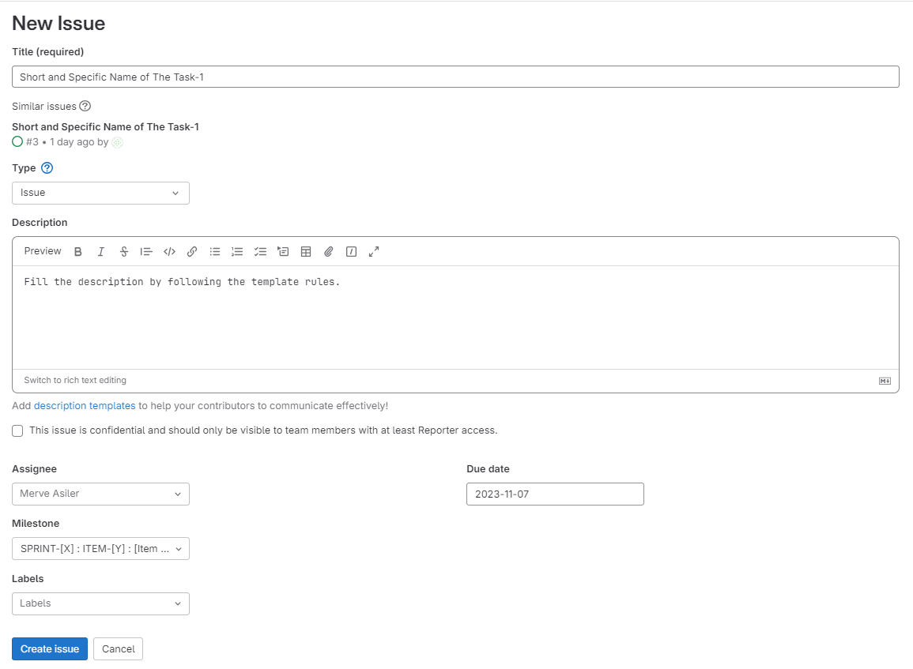
Workload Rules - Gitlab Rules
Issue:

Slide 52
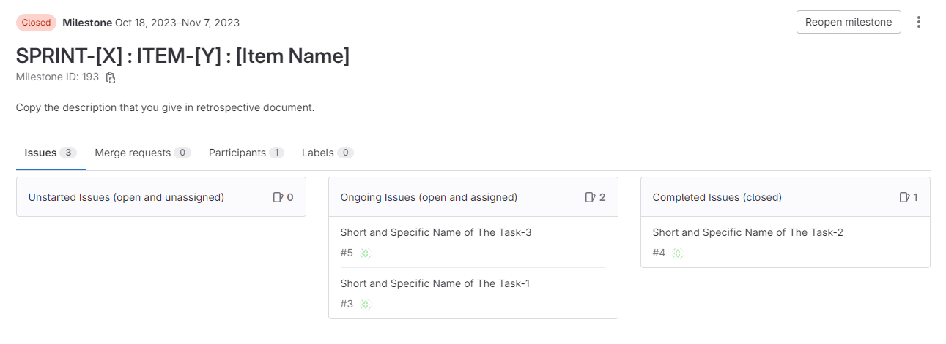
Workload Rules - Gitlab Rules
Issue:

Slide 53
Workload Rules - Gitlab Rules
Issue:
Open issues (child) under milestones (parent).
There can be many issues for each milestone.
For each specific subtask, open a separate issue. Their contents should not overlap.
Itemize everything in the issue. We give a template. Apply it.

Slide 54
Workload Rules - Gitlab Rules
Issue:
Each issue is individual (Specific to each group member).
In other words, an issue cannot be shared by multiple members. Assign to single person.
Also, group members are not allowed to open different issues summarizing the same task.
WEP grade of a member is evaluated over only the closed issues!
There can be many issues for each member at each WEP. Issues of a member can be from the same milestone or different milestones.

Slide 55
Workload Rules - Gitlab Rules
Issue:
Actually, we expect you to handle more than 1 issue at each sprint since each sprint is 3-week-long. Ideally, it would be good open at least 3 issues where each corresponds to one week.
We can not give you a definite metric to measure the sufficiency of your individual workload. However, your supervisor generally gives you approximately 18 to 21-hour-work for each single member at each 3-week duration. Therefore, this is the approximate measure that we use to evaluate the sufficiency of your issues.

Slide 56
Workload Rules - Gitlab Rules
Issue - template
Title: [Short and Specific Name of The Task]
Each of the following items should be a seperate short paragraph:
[DEFINITION] Define the task that you did. [1-2 sentences]
[REASON/PURPOSE] Why did you need this task in this project? What is the requirement that pushes you to do this task? [1-3 sentences]
[HOW?] Explain how you did this task. This is dependent on whether it is a research task or implementation task.
Research Task: The ones that you did NOT write “your own code”.
Implementation Task: The ones that consists of “your own work/code”.
[FINAL NOTES] Specify the final comments. State if the results are sufficient or not. State if there is a new idea/plan coming with this task. [1-3 sentences]

Slide 57
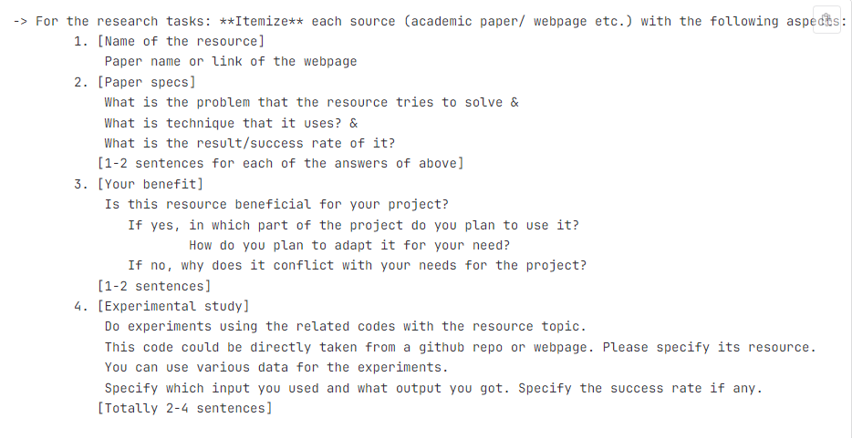
Workload Rules - Gitlab Rules
Issue - template - “HOW? Part” - Research Task
Please do not link online libraries/repos.
Also do not push compilation artifacts too.

Slide 58
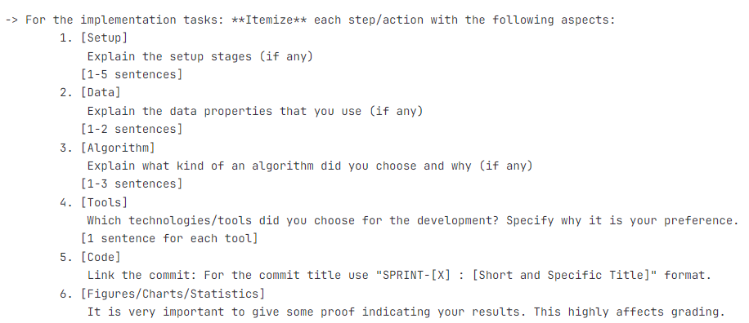
Workload Rules - Gitlab Rules
Issue - template - “HOW? Part” - Implementation Task

Slide 59
